Slide 1

Critical Issues in Administration
June 11, 2012
Find us on Twitter @instructionalle

Slide 2
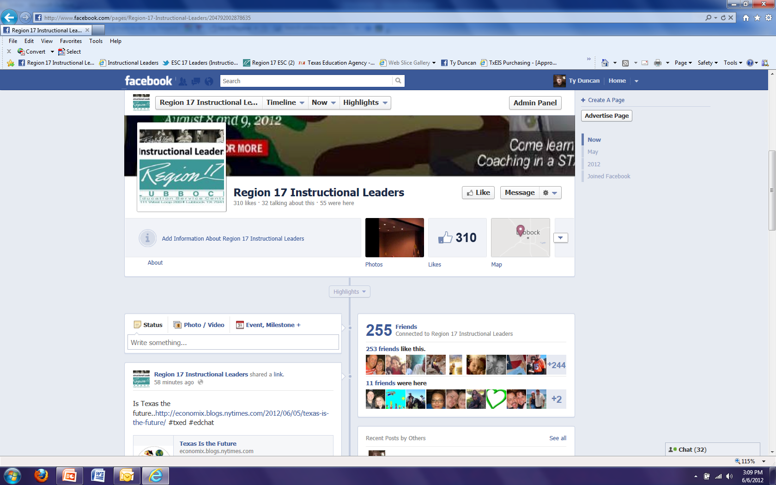
“Like” Our Wall
http://www.facebook.com/pages/Region-17-Instructional-Leaders/204792002878635

Slide 3
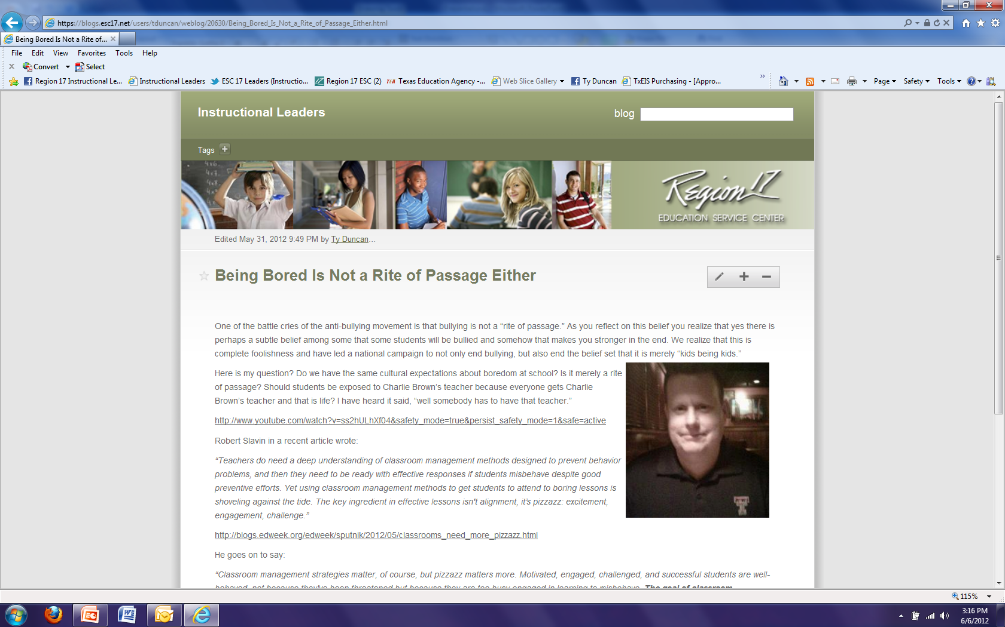
https://blogs.esc17.net/users/tduncan/

Slide 4
Use #ESC17 on Twitter
For anything you find interesting
Things you want to share
Things that can help districts in Region 17 thrive
If you are a leader and are not tweeting or have a twitter feed you are getting behind the curve quickly. We live in exponential times. http://georgecouros.ca/blog/social-media-for-administrators

Slide 5
EOC Cut Scores
Test | Minimum | Satisfactory at Phase in | Satisfactory at Recommended | Advanced | Total Points Possible
English 1 Reading | 27 | 30 | 36 | 46 | 56
English 1 Writing | 37 | 40 | 45 | 57 | 62
Algebra 1 | 17 | 20 | 34 | 42 | 54
World Geography | 27 | 31 | 47 | 57 | 68
Biology | 17 | 20 | 34 | 45 | 54

Slide 6
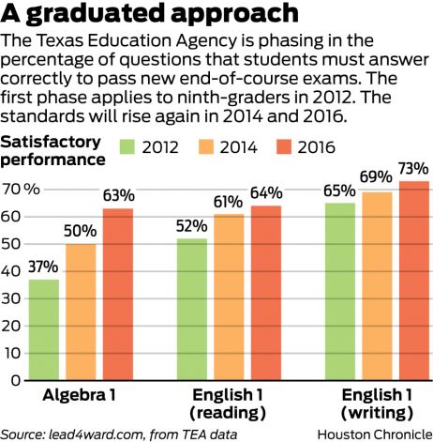
STAAR Passing Standards
http://www.chron.com/news/houston-texas/article/Passing-standards-on-new-high-school-tests-called-3611621.php

Slide 7
Level I and Level III Phase In
 |  | Phase-in 1 |  |  | Phase-in 1 |  |  | Phase-in 2 |  |  | Phase-in 2 |  |  | Final
Content Area | EOC Assessments | 2012 |  |  | 2013 |  |  | 2014 |  |  | 2015 |  |  | 2016
 |  | Minimum | Level II | Level III | Minimum | Level II | Level III | Minimum | Level II | Level III | Minimum | Level II | Level III | Minimum | Level II | Level III
ELA | English I Reading | 1813 | 1875 |  | 1813 | 1875 |  | 1887 | 1950 | 2304 | 1887 | 1950 | 2304 | 1936 | 2000 | 2304
ELA | English II Reading | 1806 | 1875 |  | 1806 | 1875 |  | 1880 | 1950 | 2328 | 1880 | 1950 | 2328 | 1929 | 2000 | 2328
ELA | English III Reading | 1808 | 1875 | 2135 | 1808 | 1875 | 2135 | 1882 | 1950 | 2356 | 1882 | 1950 | 2356 | 1932 | 2000 | 2356
ELA | English I Writing | 1798 | 1875 |  | 1798 | 1875 |  | 1872 | 1950 | 2476 | 1872 | 1950 | 2476 | 1921 | 2000 | 2476
ELA | English II Writing | 1807 | 1875 |  | 1807 | 1875 |  | 1880 | 1950 | 2408 | 1880 | 1950 | 2408 | 1928 | 2000 | 2408
ELA | English III Writing | 1808 | 1875 | 2155 | 1808 | 1875 | 2155 | 1881 | 1950 | 2300 | 1881 | 1950 | 2300 | 1929 | 2000 | 2300
Math | Algebra I | 3371 | 3500 |  | 3371 | 3500 |  | 3626 | 3750 | 4333 | 3626 | 3750 | 4333 | 3872 | 4000 | 4333
Math | Algebra II | 3350 | 3500 | 4080 | 3350 | 3500 | 4080 | 3604 | 3750 | 4411 | 3604 | 3750 | 4411 | 3852 | 4000 | 4411
Math | Geometry | 3362 | 3500 |  | 3362 | 3500 |  | 3619 | 3750 | 4397 | 3619 | 3750 | 4397 | 3868 | 4000 | 4397
Science | Biology | 3367 | 3500 |  | 3367 | 3500 |  | 3621 | 3750 | 4576 | 3621 | 3750 | 4576 | 3868 | 4000 | 4576
Science | Chemistry | 3348 | 3500 |  | 3348 | 3500 |  | 3600 | 3750 | 4607 | 3600 | 3750 | 4607 | 3846 | 4000 | 4607
Science | Physics | 3346 | 3500 |  | 3346 | 3500 |  | 3600 | 3750 | 4499 | 3600 | 3750 | 4499 | 3848 | 4000 | 4499
Social Studies | World Geography | 3383 | 3500 |  | 3383 | 3500 |  | 3632 | 3750 | 4404 | 3632 | 3750 | 4404 | 3874 | 4000 | 4404
Social Studies | World History | 3326 | 3500 |  | 3326 | 3500 |  | 3576 | 3750 | 4634 | 3576 | 3750 | 4634 | 3822 | 4000 | 4634
Social Studies | U.S. History | 3372 | 3500 |  | 3372 | 3500 |  | 3624 | 3750 | 4440 | 3624 | 3750 | 4440 | 3869 | 4000 | 4440

Slide 8
Just Passing Is Not Enough For Elementary and Junior High Students Either

Slide 9
Full Level III in 2014

Slide 10
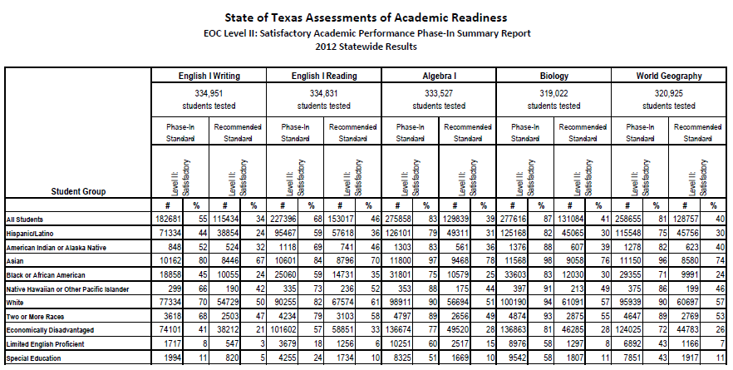

Slide 11
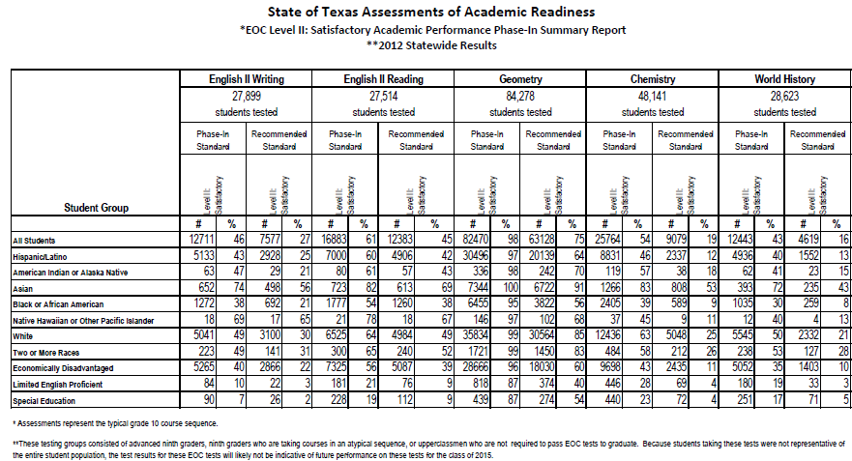

Slide 12
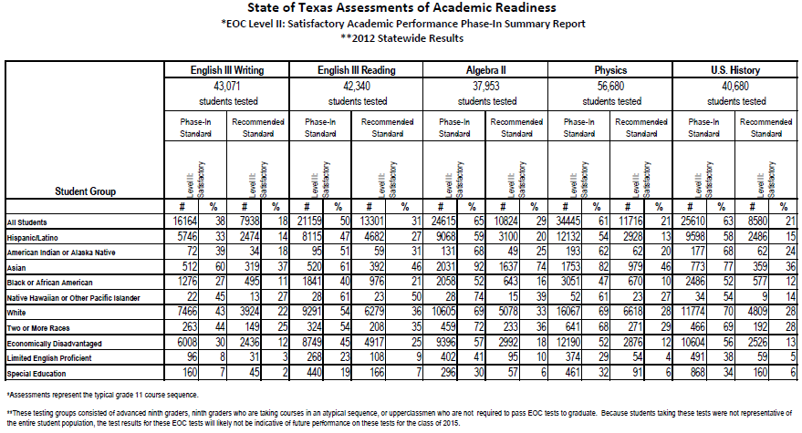

Slide 13
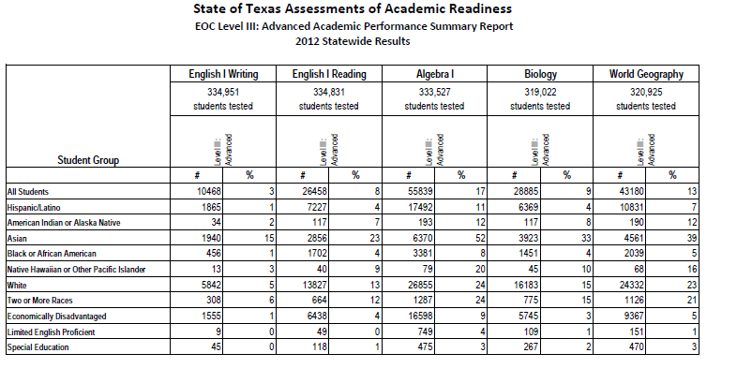

Slide 14
3-8 Scores
Take your scores and figure passing at
  50%
  60%
  70%
Also take a look at the number of students who scored a 90%
  Will you keep them there?

Slide 15
Lubbock ISD District Assessment and STAAR Correlations
Mike Sizemore
K-12 Science Coordinator
Amador Vasquez
K-12 Math Coordinator

Slide 16
District Assessments
District Assessments began in the 2010-2011 school year with our adoption of CSCOPE.
Unit Assessments 1-4 times per six-weeks in all four core content areas for grades 2-12.
Changed in the 2011-2012 school year.
Six, Six-Week assessments in all four core content areas for grades 2-12.

Slide 17
Goals
Monitoring learning and classroom instruction
Identifying students and content for intervention
Predictive measure of student performance on STAAR

Slide 18
Assessment Creation Process
Teacher Teams
District Level Instructional Coaches
Content Coordinators
Assistant Superintendent for Curriculum and Instruction

Slide 19
Teacher Sentiment During the School Year
Too hard
Not aligned
Used as a punitive “gotcha”

Slide 20
The Results
Once STAAR results were released the percentage of questions answered correctly on the various STAAR assessments were compared with the percentage of questions answered correctly on the district assessments.

Slide 21
5th Grade Science

Slide 22
5th Grade Science
Correlation: 0.85

Slide 23
8th Grade Science

Slide 24
8th Grade Science

Slide 25
5th Grade Math

Slide 26
5th Grade Math
Correlation: 0.92

Slide 27
8th Grade Math

Slide 28
8th Grade Math
Correlation: 0.90

Slide 29
Teacher Comments
“…given that practice should be more intense than the game, would it be a problem to increase the rigor on the middle school tests a little?”
“That's great. Guess it was worth taking all those really difficult tests you guys made up. Thanks for your diligent work.”
“Close running between the two. Kudos for writing assessments with the rigor of STARR.”
“Several hypotheses can be generated based on this data depending on the angle one wants to take such as trends in 5th through biology, valid comparison between our district assessments and the STAAR (an assessment we have only seen snapshots), etc. I am impressed the scores between the two were not light-years different.”

Slide 30
Cultural Change
“Structural change that is not supported by cultural change will eventually be overwhelmed by the culture, for it is in the culture that any organization finds meaning and stability.”
Schlechty, Shaking Up the Schoolhouse:
How to Support and Sustain Educational Innovation
(2001), p. 52

Slide 31
Casual Approach To Schooling Will Get You Killed
A response to a teacher I gave recently not pleased with her students’ performance:
  I will say social studies teachers generally must expect more. Students must see primary sources 4 times a week and talk about them out loud for a grade. Writing and talking must be the grades. Worksheets will not mean a lot. Content cannot be seen only in its immediate context. It must be connected across time conceptually.
  I will say this to everyone. There is not time to waste anymore. It must be intense everyday all day and even on Friday after the pep rally. We must provide students immediate feedback when we find out they do not know something. Teachers must become as sophisticated as the lawyer or engineer in their practice and get after it with an intensity resembling Bobby Knight after a bad call. This is not casual schooling as the economy will not allow us to be casual and informal or relaxed.

Slide 32

Data HOT Spots
http://www.tea.state.tx.us/student.assessment/staar/exptested/

Slide 33
SE’s Released In Excel
GRADE | LANGUAGE | SUBJECT | ITEM | REPORTING CATEGORY | CONTENT STUDENT EXPECTATION | PROCESS STUDENT EXPECTATION | TEST DATE
8 | English | Science | 1 | 3 | 8.7(A) | 8.3(B) | 12-Apr
8 | English | Science | 2 | 2 | 7.7(A) | 8.2(E) | 12-Apr
8 | English | Science | 3 | 4 | 8.11(A) | 8.3(B) | 12-Apr
8 | English | Science | 4 | 1 | 6.5(C) |  | 12-Apr
8 | English | Science | 5 | 4 | 7.12(D) | 8.2(A) | 12-Apr
8 | English | Science | 6 | 2 | 6.8(D) |  | 12-Apr
8 | English | Science | 7 | 3 | 8.8(A) |  | 12-Apr
8 | English | Science | 8 | 2 | 6.9(C) | 8.3(B) | 12-Apr
8 | English | Science | 9 | 1 | 8.5(D) | 8.3(D) | 12-Apr
8 | English | Science | 10 | 2 | 8.6(A) |  | 12-Apr
8 | English | Science | 11 | 1 | 6.6(B) | 8.2(E) | 12-Apr
8 | English | Science | 12 | 3 | 7.8(C) | 8.3(B) | 12-Apr
8 | English | Science | 13 | 1 | 7.6(A) | 8.3(B) | 12-Apr

Slide 34
Social
Studies
Science
Notes:
4:05

Slide 35
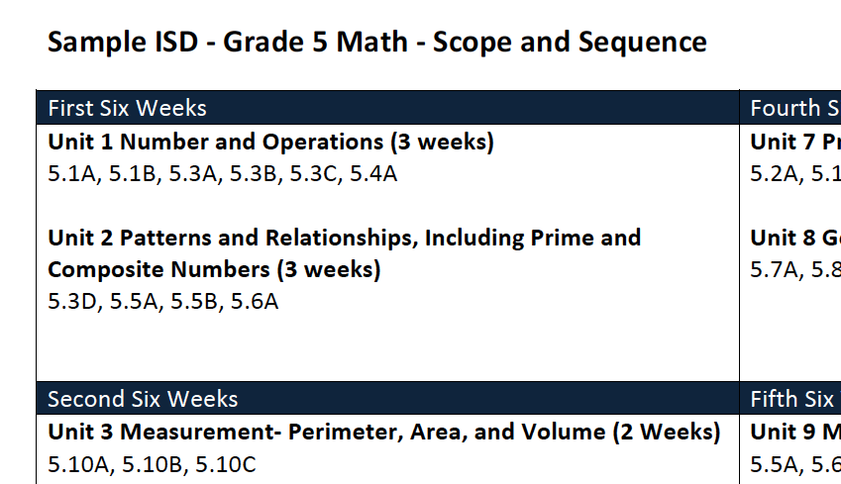

Slide 36
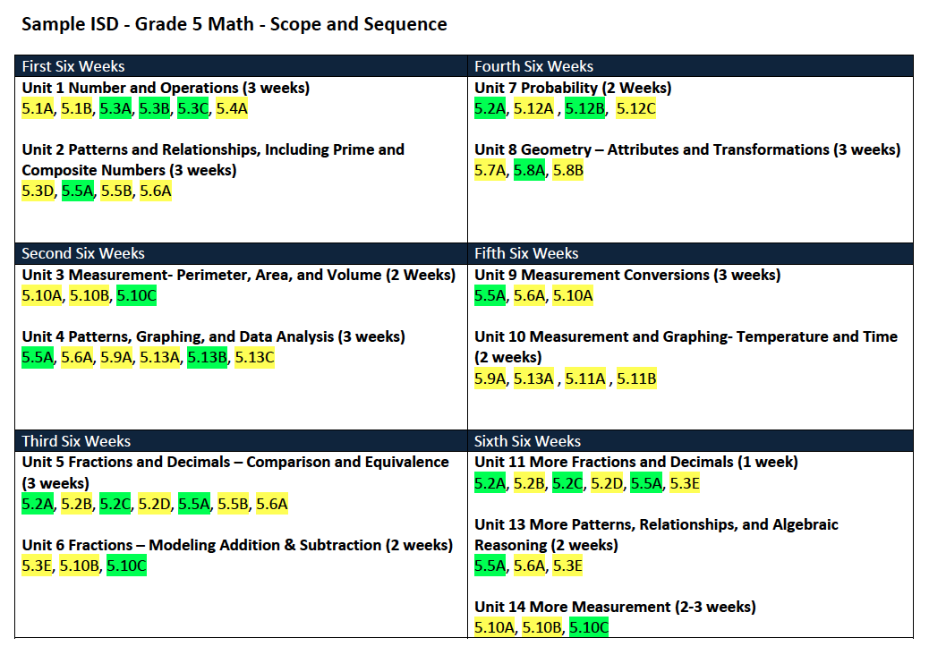
Notes:
4:20

Slide 37
LaminaTE THIS SUCKER
Notes:
4:20

Slide 38


Slide 39
Panel Discussion
ELA Writing Scores are a bit of a problem not only in our region, but in the state as a whole. What must we do to prepare students to be writers by the time they get to high school?
One of the discussions we have around our place is making PD worthwhile. What must leaders do to ensure that the PD teachers are getting is making a difference in their craft?
How do we get teachers to be more conceptual in their approach?
8th grade social studies scores are not very good. Social studies teachers generally got complacent and did not change much of anything. What are you going to do this year to ensure social studies teachers and all of your teachers for that matter pick up their game even more?
Data indicates very average student engagement in most classrooms across the nation. In fact most will say boredom at school is our single biggest problem!! What can we do to get students invested in their own learning and teachers to teach with a little pizzazz and sophistication at the same time?
How do we reach middle school students? How do we set up schools and classrooms so students make growth during the years? We need to find a way to continue the success of our elementary grades.

Slide 40
Accountability 2013 and Beyond
Public Website
  http://ritter.tea.state.tx.us/perfreport/account/2013/index.html
The ATAC committee will be recommending a Performance Index Model to the APAC group in November.
EOC is a very complex system and thus very difficult to create a system around and also one that is difficult to figure out how to give positive credit for growth.

Slide 41
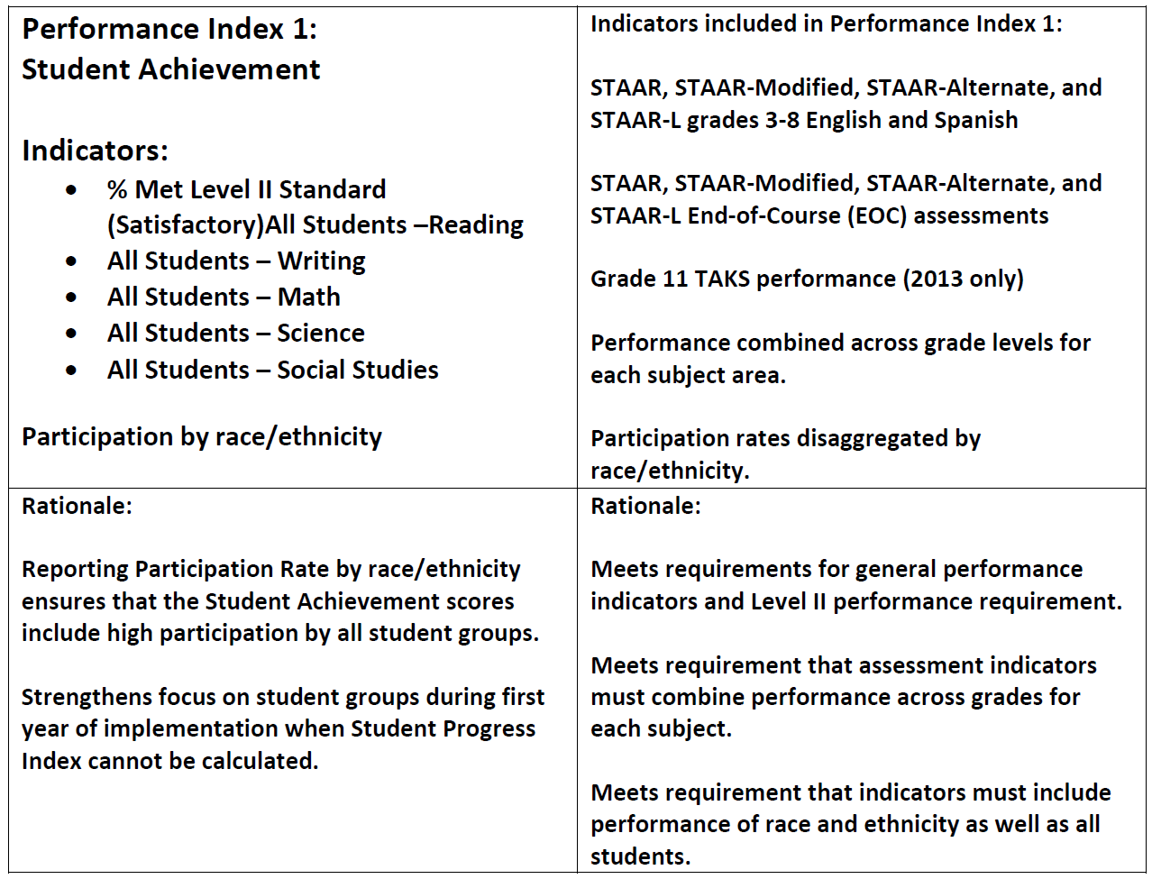

Slide 42
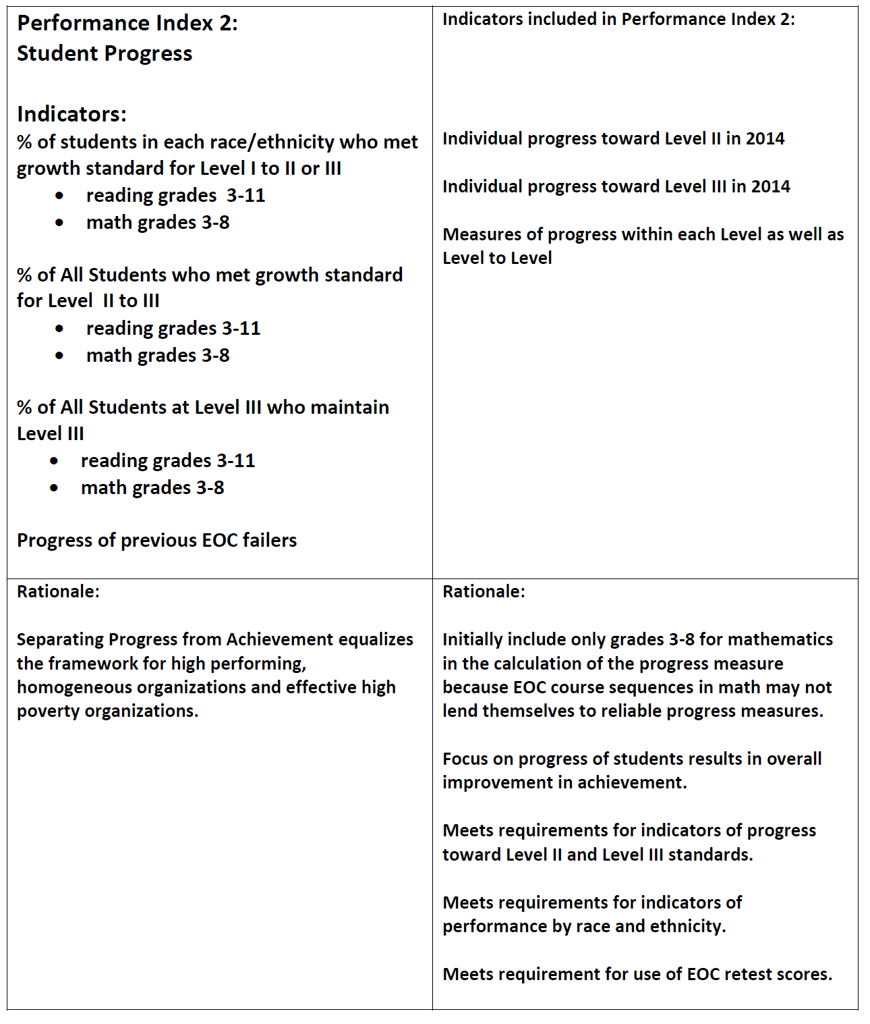

Slide 43
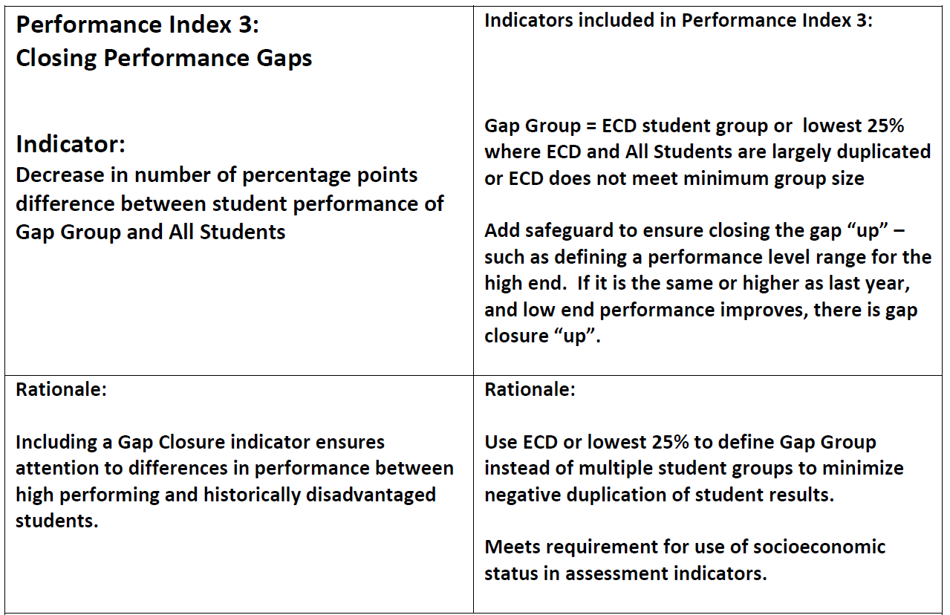

Slide 44
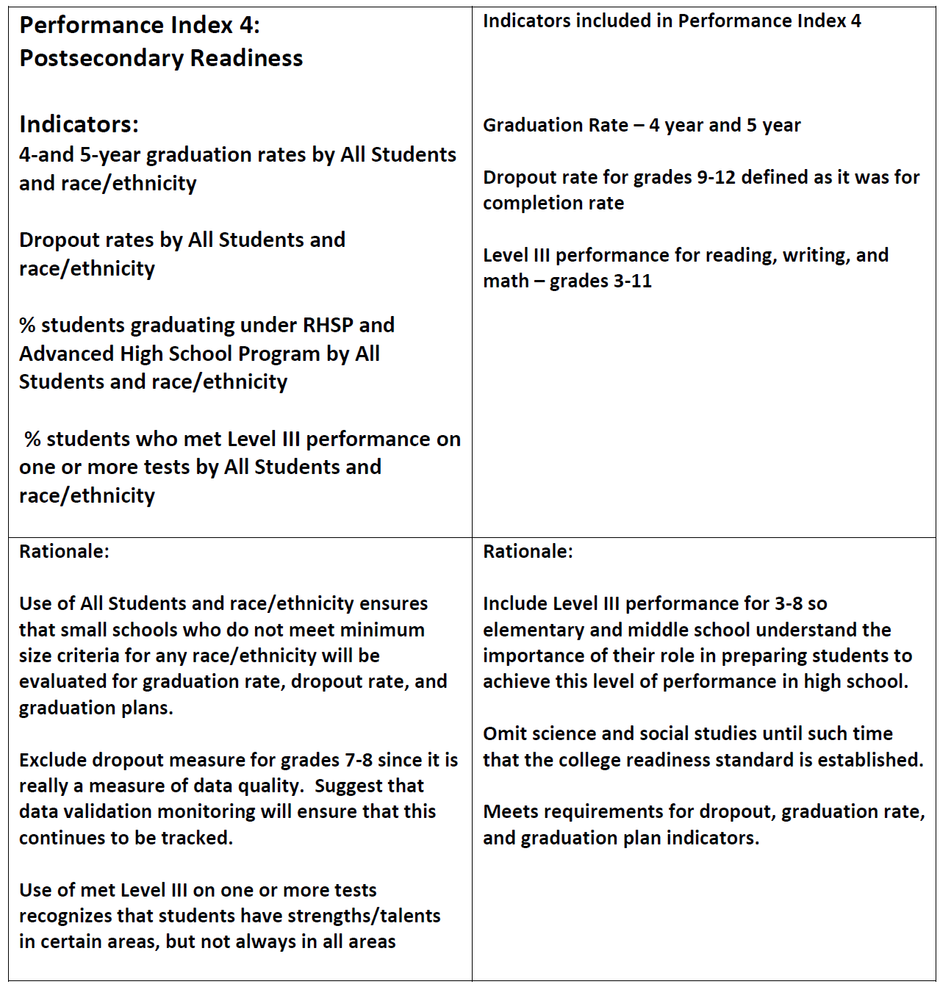

Slide 45
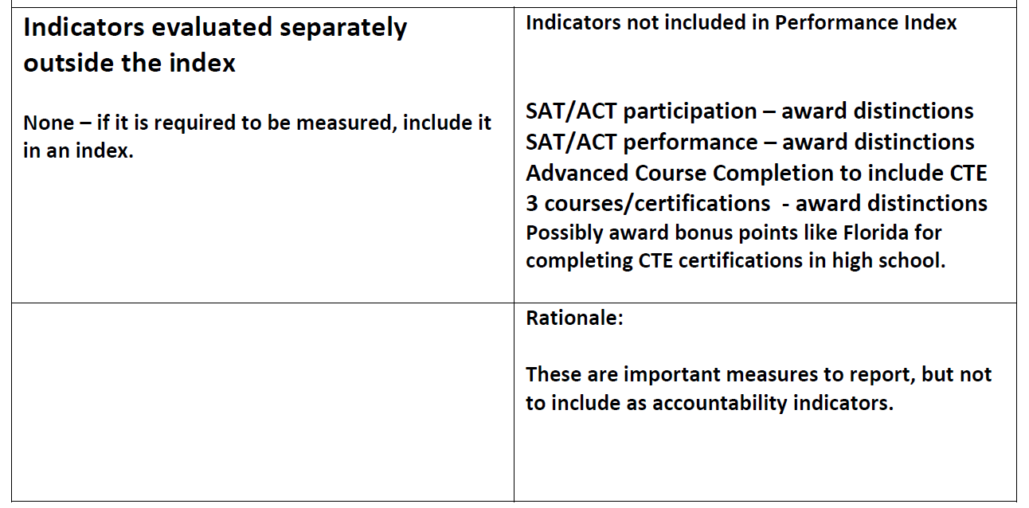

Slide 46
Acceptable/
Unacceptable

Slide 47
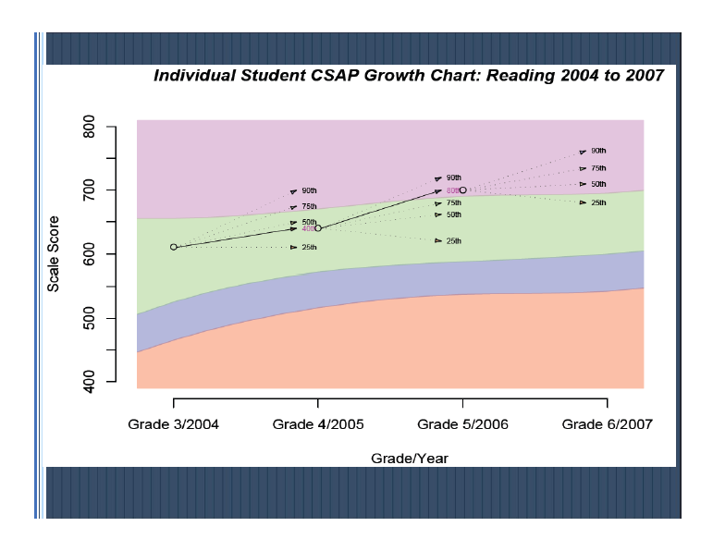
Growth Models
http://www.ksde.org/LinkClick.aspx?fileticket=9ZeUx9Y9nzw%3D&tabid=116

Slide 48
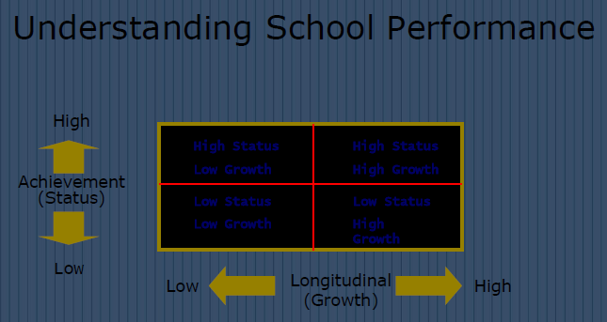
Growth Models
http://www.ksde.org/LinkClick.aspx?fileticket=9ZeUx9Y9nzw%3D&tabid=116

Slide 49

http://escite2.esc17.net/default.aspx?name=wmsworkshop&w=12033

